Slide 1
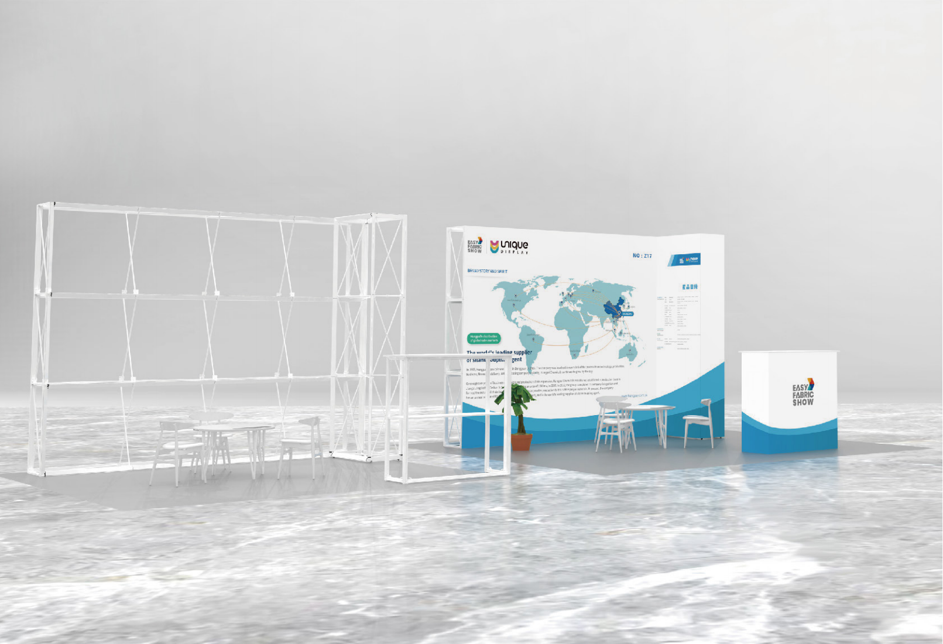

New EconomySEG Banner Stands Roll Up Replacement Revolution
Economy SEG Banner stands with steel feet Similar packing size as Wide base Rollup
NEW Economy Tube Banner stands Roll Up Replacement Revolution
Economy Tube Banner stands with slim feet
Same packing size as Economy Rollup
www.eaglefocus.com.hk

Slide 2





Eaglefocus
A professional comprehensive enterprise,which is specialized in display equipment research and development,
production, sales, and exhibition design .Our company's main product is Table Throw,Roll Up Stand, Pop Up
Display, Light Box, Flag,and so on . . .and we use more advanced thermal transfer printing technology,make your
picture more three-dimensional, more colorful .Our portable and collapsible products are easy for transportation,
Assemble and dismantle,their beauty and time-saving feature are ideal for brand promotion,exhibition, and product
demonstrations .Competitive price,very good product quality,perfect pre-sale and after-sales service is the core
competitiveness of our company.
WEDDING DISPLAY EQUIPMENT 01
EASY FABRIC BANNER STANDS13
TUBE TENSION FABRIC WALL 19
COUNTERS 27
SINGULAR DISPLAY 25
3D DISPLAY STANDS 33
ACCESSORIES 43
BOOTH SOLUTION 49
EASY POP UP DISPLAY 57
OUTDOOR DISPLAY 61
SEG DISPLAY 67
ROLL UP BANNER STAND 71

Slide 3


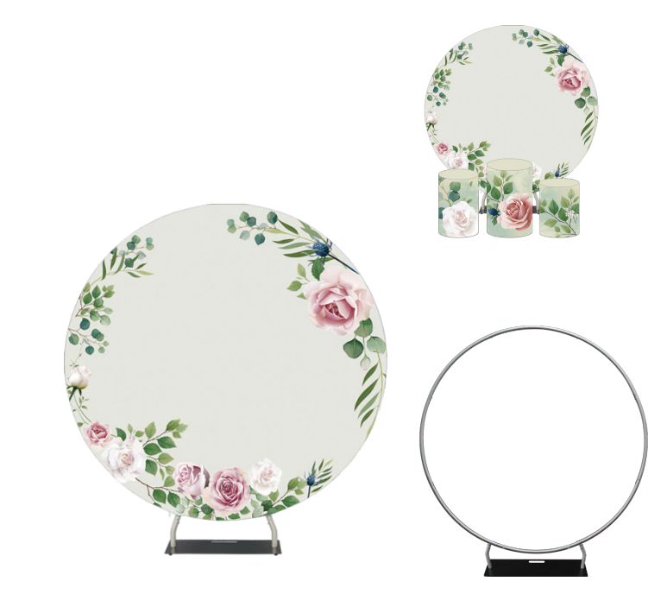






ROUND BACKGROUND
WEDDING
DISPLAY
EQUIPMENT
Roll up Banner Stand is the perfect portable banner stand for showing
your graphic promotions on the move. Our graphic retractable banner
stand display will vividly communicate your message! Take it with you to
your next Trade Show, Exhibition, Seminar, Presentation or Promotional
Event!
ZD-RB32
Round Background (32 tubes)
WEDDING DISPLAY EQUIPMENT
Round Background Specification
ZD-RB32
2300×2300
2300×2300
11.5
28x17x100
1500×1500
1500×1500
7.6
27×16×89
1800×1800
1800×1800
8.3
27x16x89
2000×2000
2000×2000
8.7
27x16x89
2200×2200
2200×2000
10.75
28x17x100
2500×2500
2500×2500
13.0
28x17x100
01
02
www.eaglefocus.com.hk

Slide 4

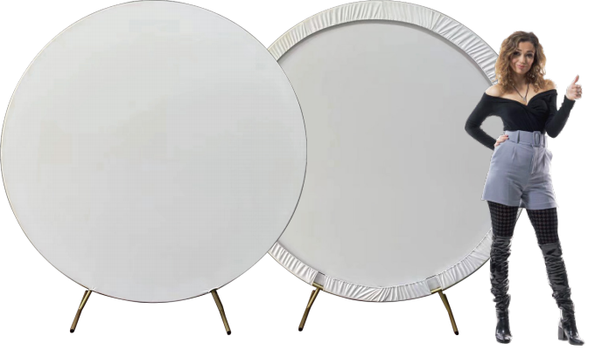
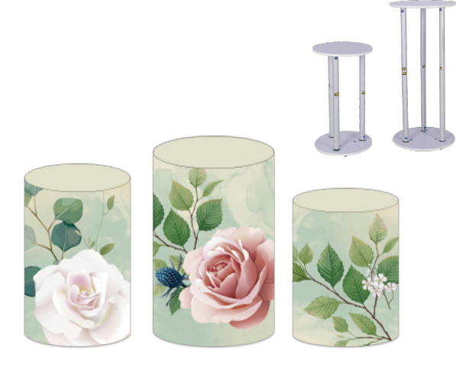


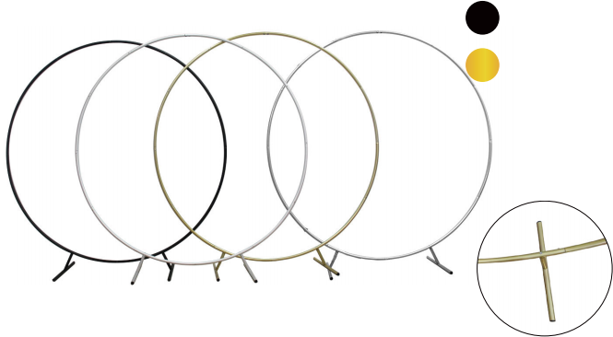



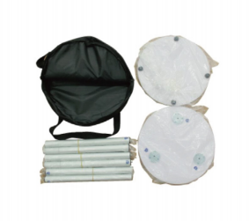
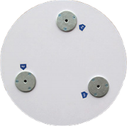
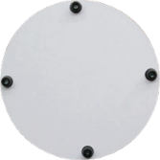



ROUND BACKGROUND (25TUBE)
ROUND TABLE
ZD-RB25
Round Background (25 tubes)
Black
Gold
White
Silver
ZD-T02
ZD-T03
ZD-T01
Round Table Specification
ZD-T01
330x600
330x600
3.8
45x45x10
ZD-T02
360x750
360x750
4.8
45x45x10
ZD-T03
400x900
400x900
5.5
45x45x10
WEDDING DISPLAY EQUIPMENT
Round Background Specification
ZD-RB25
2000x2000
1800x1800
5.0
26x17x45
1800x1800
1800x1800
4.5
26x17x45
03
04
www.eaglefocus.com.hk

Slide 5

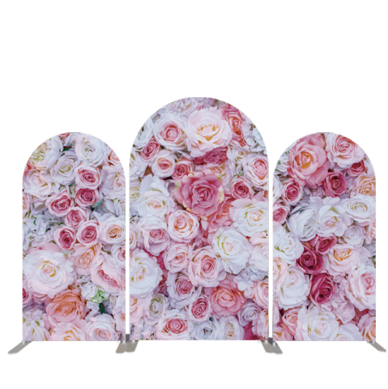
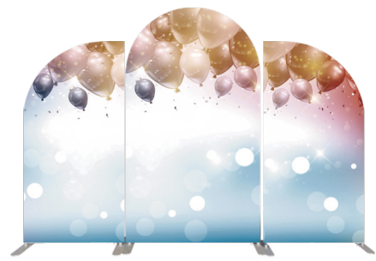
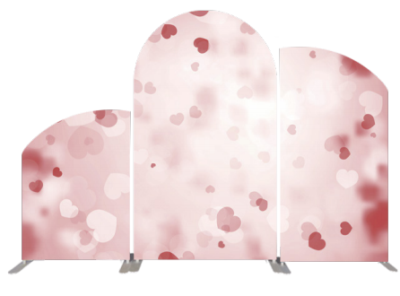

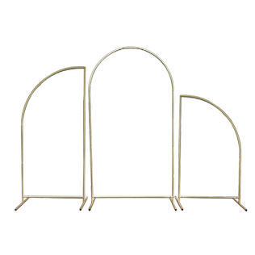
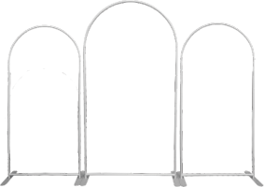

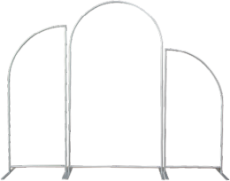

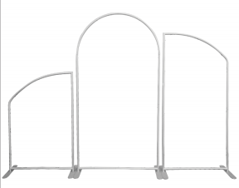
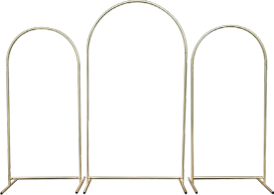

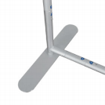






ARCHED
ZD-AB01
Arched Background
ZD-AB01
Arched Background
ZD-AB01
Arched Background
ZD-AB02
Beveled Arched
ZD-AB01
Arched Background
ZD-AB02
Beveled Arched
ZD-AB03
Concave series-Squre
ZD-AB01
Concave series-Squre
ZD-AB03
Concave series-Squre
ZD-AB02-2
Beveled Arched(Gold 25 tubes)
Gold
Gold
WEDDING DISPLAY
ZD-AB01-2
Arched Background(Gold 25 tubes)
Arched Specification
Arched Specification
Arched Specification
EQUIPMENT
ZD-AB01(01-2)
914.4×1828
914.4×1828
4.1
24.5×18.5×77
ZD-AB02 (02-2)
914.4×1828
914.4×1828
4.1
24.5×18.5×77
ZD-AB03
914.4×1828
914.4×1828
4.1
24.5×18.5×77
914.4×1219.2
914.4×1219.2
3.75
24.5×18.5×77
1219.2x2133.6
1219.2x2133.6
4.5
24.5×18.5×77
914.4×1219.2
914.4×1219.2
3.75
24.5×18.5×77
1219.2x2133.6
1219.2x2133.6
4.5
24.5×18.5×77
914.4×1219.2
914.4×1219.2
3.75
24.5×18.5×77
1219.2x2133.6
1219.2x2133.6
4.5
24.5×18.5×77
05
06
www.eaglefocus.com.hk

Slide 6

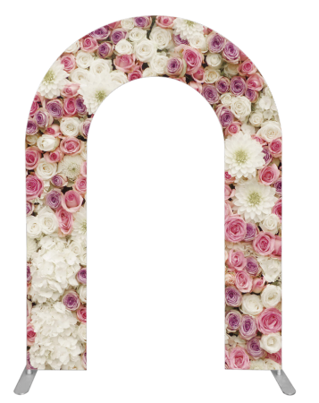
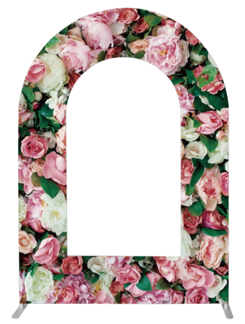
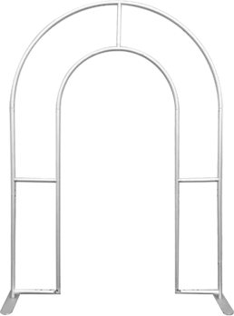
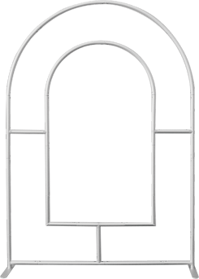
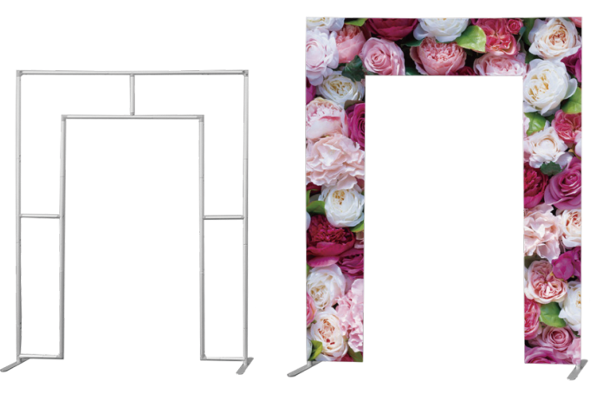






ARCHED DOOR
ZD-R03
ZD-R01
Arched Door (arched)
ZD-R02
Arched Door (rectangular arch)
Arched Door (window arch)
Arched Door Specification | Arched Door Specification
 | 1219.2x2133.6 1219.2x2133.6 6 24.5×18.5×77 | ZD-R01 1524×2133.6 1524×2133.6 6.5 24.5×18.5×77
 | 1219.2x2133.6 1219.2x2133.6 6 24.5×18.5×77 | ZD-R02 1524×2133.6 1524×2133.6 6.5 24.5×18.5×77
WEDDING DISPLAY EQUIPMENT
Arched Door Specification
 | 1219.2x2133.6 1219.2x2133.6 6 24.5×18.5×77 | ZD-R03 1524×2133.6 1524×2133.6 6.5 24.5×18.5×77
07
08
www.eagle-focus.com

Slide 7
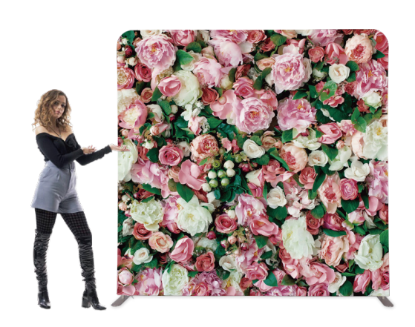

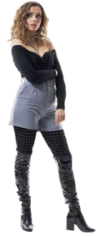

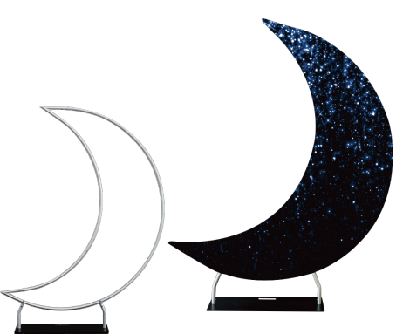
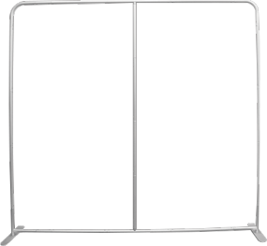





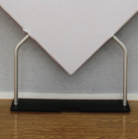
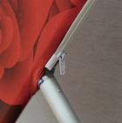
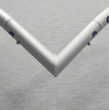
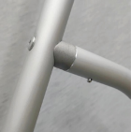


STRAIGHT BACKGROUND SPECIAL SHAPE
ZD-ST8
Straight Background
ZD-HS
Special Shape (heart shape)
Special Shape (heart) Specification
ZD-HS
2000x2000
2000x2000
6
45x45x10
ZD-MS
1750x2150
1750x2150
6
45x45x10
FILLET
WEDDING DISPLAY
RIGHT ANGLE
ZD-MS
Special Shape (moon shape)
Straight background Specification
ZD-ST8
1219.2x2133.6
1219.2x2133.6
5.25
24.5×18.5×77
EQUIPMENT
914.4×1219.2
914.4×1219.2
3.75
24.5×18.5×77
914.4×1828
914.4×1828
4.1
24.5×18.5×77
2438x2438
2438x2438
8.7
29x22x89
3048x3048
3048x3048
9
29x22x89
09
10
www.eaglefocus.com.hk

Slide 8
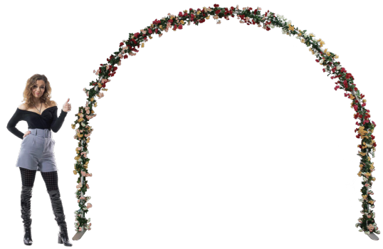
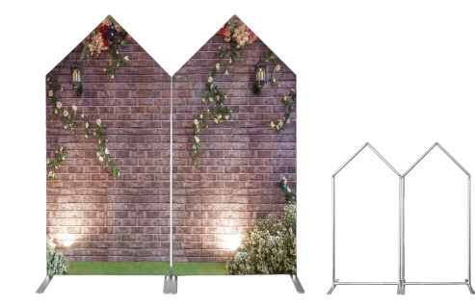


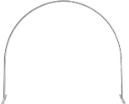
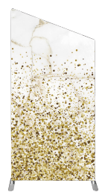
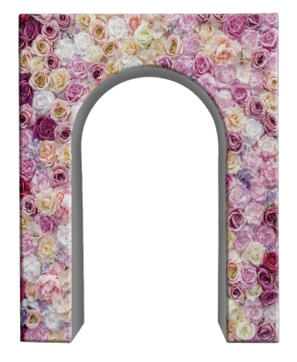



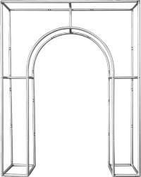

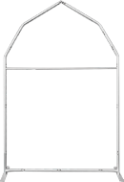







SPECIAL SHAPE
Special Shape(conical) Specification
ZD-R05
Flower Arch
 | 914.4×1219.2 914.4×1219.2 3.75 24.5×18.5×77 | ZD-R06 914.4×1828 914.4×1828 4.1 24.5×18.5×77 | 1219.2x2133.6 1219.2x2133.6 4.5 24.5×18.5×77
ZD-R06
Special Shape(conical)
ZD-R06
Special Shape(conical)
Special Shape Specification ZD-R09 1219.2x2133.6 1219.2x2133.6 4.5 24.5×18.5×77 ZD-R07 Special Shape(house) | ZD-R09 Oblique Straight Special Shape Specification ZD-R07 1520x2300 1520x2300 6.5 24.5×18.5×77
Special Shape Specification ZD-R04 1524x350×2130 1524x350×2130 7.5 24.5×18.5×77 | ZD-R04 Stereo Arch Special Shape Specification ZD-05 6000x3000 6000x3000 4.5 24.5×18.5×77 | WEDDING DISPLAY EQUIPMENT
914.4×1219.2
914.4×1219.2
3.75
24.5×18.5×77
914.4×1828
914.4×1828
4.1
24.5×18.5×77
11
12
www.eaglefocus.com.hk

Slide 9


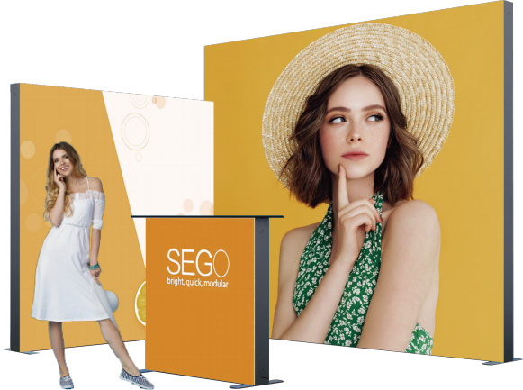



SEGO LIGHTBOX
QSEG
EASY
FABRIC BANNER STANDS
Easy fabric banner stands includes 24”, 30”, 31.5”,
33.5”, 36”, 48”, 60” etc di erent width to meet
di erent kinds of demands, which can replace traditional roll up banner stands graphic not straight in PVC or Vinyl material, which is also much stable and elegant, portable and shining with textile material for graphic.
ZD-LB(12cm)
Lightbox
SEGO Lightbox
Item ZD-LB(12cm)
Frame size(mm) 500×1500 850×1500 850×2000 850×2250 850×2400 850×2500 1000×1500 1000×2000 1000×2250
Graphic Size(mm) 500×1500 850×1500 850×2000 850×2250 850×2400 850×2500 1000×1500 1000×2000 1000×2250
Weight( Kg ) 13.5 14 14.5 14.8 15 15.5 16 17.5 17
^{Packing} ^{Size(cm)} 22×18.5×116 22×18.5×116 22×18.5×116 22×18.5×116 22×18.5×116 22×18.5×116 22×18.5×124 22×18.5×124 22×18.5×124
EASY FABRIC BANNER STANDS
SEGO Lightbox
Item ZD-LB(12cm)
Frame size(mm) 1000×2500 2000×2000 2000×2250 2000×2400 2000×2500 ^{3000×2000} ^{3000×2250} ^{3000×2400} ^{3000×2500}
Graphic Size(mm) 1000×2500 2000×2000 2000×2250 2000×2400 2000×2500 3000×2000 3000×2250 3000×2400 3000×2500
Weight( Kg ) 18 18.5 19 19.5 20 21 21.5 22 23
^{Packing} ^{Size(cm)} 22×18.5×154 22×22×154 22×22×154 22×22×154 22×22×154 22×22×154 22×22×154 22×22×154 22×22×154
13
14
www.eaglefocus.com.hk

Slide 10

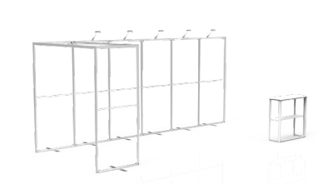
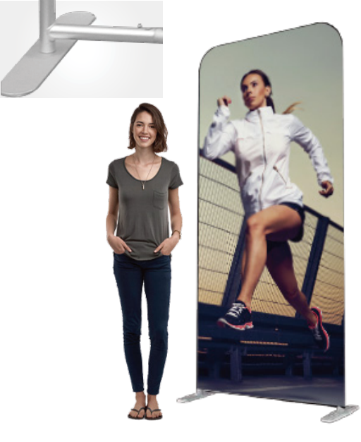

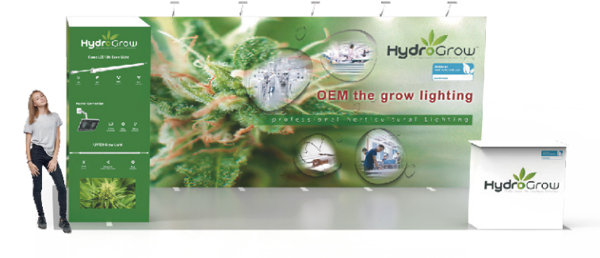
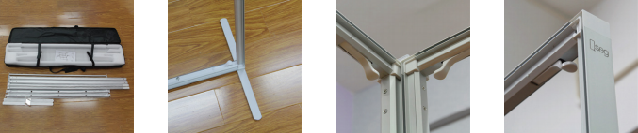


QSEG BANNER STANDS
QSEG Banner Stands includes 24”, 30”,
which can replace traditional roll up
banner stands to graphic not quite
straight, which is also much stable and
elegant, portable and shining.
ZD-BS(4cm)
QSEG
TUBE LIGHTBOX SERIES
Illuminate your message with the 43mm Tube Light Wall! Lumiere LED ladder lights made graphics pop on this innovative display of tube graphics.
Multiple Tube Light Walls can be connected together to create a larger backwall, easy install and carrying.
QSEG Banner Stands Specification
Item Frame size(mm) Graphic Size(mm) Weight( Kg ) Packing Size(cm) | 500×1500 500×1500 4.8 111×9×16 | 850×2000 850×2000 5.7 111×9×32 | 1000×2000 1000×2000 5.9 111×9×32 | 1200×2000 1200×2000 6.3 131×10×32 | ZD-BS(4cm) 1000×2250 1000×2250 6.2 120×10×26 | 1200×2250 1200×2250 6.5 131×10×32 | 2400×2250 2400×2250 11.5 131×10×32 | 3000×2250 3000×2250 15.3 120×26×26 | 1000×1000 1000×1000 4.4 111×9×16
EASY FABRIC BANNER STANDS
Item ZD-TLB
Frame size(mm) 800×2280 85×2280 917×2280 1000×2280 1222×2280 1524×2280 2438×2280 2922×2280
Graphic Size(mm) 840×2230 900×2230 960×2230 1050×2230 1270×2230 1570×2230 2480×2230 2970×2230
Weight( Kg ) 10.5 11.5 12 12.5 15.5 19 30 36
Packing Size(cm) 78×25×25 78×25×25 78×25×25 78×25×25 78×35×35 78×35×35 78×35×35 78×35×35
15
16
www.eagle-focus.com

Slide 11

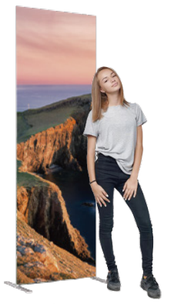
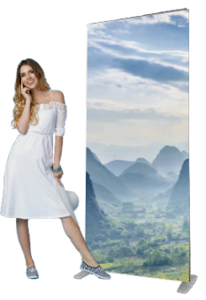
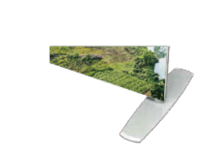

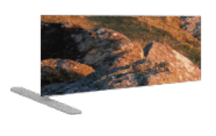



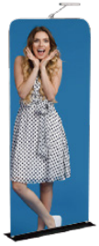
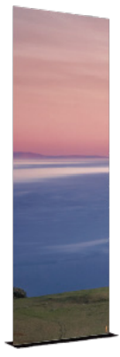
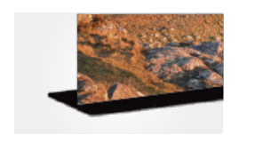
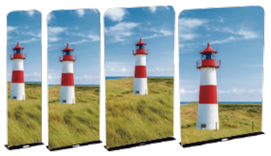



ECONOMY TUBE BANNER STANDS
PREMIUM TUBE BANNER STANDS
Economy Tube Banner stands with slim steel feet includes 24”, 30”, 31.5”, 33.5”, 36”, 48”, 60” etc
Premium Tube Banner stands with steel feet includes24”, 30”, 31.5”, 33.5”, 36”, 48”, 60”,
79”,96”,120”,
replace retractable banners to avoid the graphic not quite straight issues, which is also much stable and elegant.
ZD-ST-25
Economy tube Banner Stand
24'' 612×2280mm
30'' 762×2280mm
31.5'' 800×2280mm
33.5'' 850×2280mm
36'' 917×2280mm
48'' 1222×2280mm
60'' 1526×2280mm
demands, which can replace roll up banners to avoid the graphic not quite straight issues, which is also much stable and elegant.
Item ZD-ST-32
Frame size(mm) 612×2280 762×2280 800×2280 850×2280 917×2280 1222×2280 1526×2280 2000×2280 2438×2280 2922×2280
Graphic Size(mm) 652×2290 802×2290 840×2290 890×2290 957×2290 1262×2290 1566×2290 2040×2290 2478×2290 2962×2290
Weight( Kg ) 4 4.2 4.4 4.6 4.8 5 5.5 6 7 7.5
Packing Size(cm) 24.5×18.5×77 24.5×18.5×77 24.5×18.5×77 24.5×18.5×77 24.5×18.5×77 26.5× 26.5×74 26.5× 26.5×74 26.5× 26.5×74 26.5× 26.5×74 26.5× 26.5×74
Item
Frame size(mm)
Graphic Size(mm)
Weight( Kg )
Packing Size(cm)
ZD-ST-25
33.5” 850×2280
900×2330
4
11.5×11.5×90
24” 612×2280
650×2330
3
11.5×11.5×79
30” 762×2280
800×2330
3.5
11.5×11.5×79
31.5” 800×2280
840×2330
3.8
11.5×11.5×90
36”917×2280
960×2330
4.5
16.5×11.5×90
48”1222×2280
1270×2330
5.5
16.5×11.5×84
60”1526×2280
1570×2330
7
16.5×11.5×84
EASY FABRIC BANNER STANDS
Item
Frame size(mm)
Graphic Size(mm)
Weight( Kg )
Packing Size(cm)
ZD-TST-25
33.5”850×2280 36”917×2280
900×2330 960×2330
6.8 7
22.5×7×92 22.5×7×98.5
ZD-TST-32
Premium Tube Banner stands Application
E17U36AC
36‘’917×2280mm
24”612×2280
650×2330
30”762×2280
800×2330
6
22.5×7×83
31.5”800×2280
840×2330
6.5
22.5×7×87
48”1222×2280
1270×2330
9
22.5×11.5×81
60”1526×2280
1570×2330
11
Item ZD-TST-32
Frame size(mm) 24"612×2280 36"917×2280 48"1222×2280 60"1526×2280
Graphic Size(mm) 642×2290 947×2290 1252×2290 1556×2290
Weight( Kg ) 7 9 11 14
^{Packing} ^{Size(cm)} 29×11.5×72 28×10×100 29×10×128 29×11×161
Item
Frame size(mm)
Graphic Size(mm)
Weight( Kg )
Packing Size(cm)
ZD-TST-32
917×2280
947×2290
12
28×10×100
5.5
22.5×7×68
22.5×11.5×81
17
18
www.eagle-focus.com

Slide 12












STRAIGHT WALL SERIES
ZD-ST8
8ft Straight
ZD-ST10
10ft Straight
TUBE
TENSION FABRIC WALL
ZD-ST20
20ft Straight
ZD-HS10(ZD-S10 & ZD-P2)
10ft Straight Application
Straight Wall series including standard straight and oblique straight two
3ft 8ft,10ft, 20ft.
categories, standard straight including
Straight Wall
Item
Frame size(mm)
Graphic Size(mm)
Weight( Kg )
Packing Size(cm)
ZD-ST
10ft 2922×2280 20ft 5960×2280
ZD-HS10
10ft 2922×2280
2930×2290
11
27×27×74
35×18×83
8ft 2438×2280
2448×2280
2930×2280
5960×2280
13
37.5×37.5×76
7
7.5
27×27×74
27×27×74
More standard dimension available
Item
ZD-ST
3000×1500 4000×1500 5000×1500 6000×1500 1000×2280 1500×2280
Size
1000×1000
1500×1000
(mm) 2000×1000
2500×1000
3000×1000 4000×1000
5000×1000
6000×1000 1000×1500 1500×1500 2000×1500 2500×1500
2000×2280
2500×2280 3000×2280 4000×2280 5000×2280 6000×2280
1000×2500
1500×2500 2000×2500 1000×3000 1500×3000 2000×3000
TUBE TENSION FABRIC WALL
Frame
Our tube tension fabric systems are a great alternative to standard backwall displays. Quickly assembled in just 5 minutes, slide the tubes together to make the frame and lock in place with a push button snap. Then, simply pull the pillowcase-like graphic over the frame and zip it shut. The zipper, hidden from view, tightens the stretch fabric beautifully displaying your image.
Component schematic
19
20
www.eaglefocus.com.hk

Slide 13

















CURVED WALL SERIES
U-SHAPED WALL SERIES
Curved Wall series of clever use of mechanical design, standard sizes including 8ft, 10ft, 20ft, without, free-standing, unique simple and beautiful
U-shaped Wall series use the design of the support legs to stand, and overall more stable display rack.The design allows the screen to form the upper and
ZD-CU8
8ft Curved
ZD-CU10
10ft Curved
ZD-U8
8ft U-Shaped
ZD-U10
10ft U-Shaped
Item
ZD-HCU10
Frame size(mm)
Graphic Size(mm)
Weight( Kg )
Packing Size(cm)
ZD-CU
10ft 3000×228020ft 5960×2280
8ft 2438×2280
2560×2280
5
27×27×74
10ft 3000×2280
3150×2290
11
27×27×74 35×18×83
3150×2280
6.5
27×27×74
6150×2280
10
37×37×87
ZD-CU20
20ft Curved
Item ZD-U20 ZD-HU10
Frame size(mm)
Graphic Size(mm)
Weight( Kg )
Packing Size(cm)
More standard dimension available
10ft2750×2280
2780×2280
6.5
27×27×87
20ft6000×2280
6040×2280
13.5
37×37×104
10ft2750×2280
2780×2280
22
27×27×87
35×18×83
ZD-U20
Item
Frame (mm)
ZD-CU
20ft U-Shaped
Size
4000×2280 5000×2280
6000×2280
Component schematic
More standard dimension available
TUBE TENSION FABRIC WALL
Item
ZD-U20
Size
1000×1000
(mm)
1500×1000
2000×1000
2500×1000
3000×1000
4000×1000
5000×1000
6000×1000
Frame
ZD-HU10(ZD-U10 & ZD-P1)
10ft U-Shaped Application
Component schematic
ZD-HCU10(ZD-CU10 & ZD-P3)
10ft Curved Application
21
22
www.eaglefocus.com.hk

Slide 14









C-SHAPED WALL SERIES
S-SHAPED WALL SERIES
C-Shaped Wall series use curved design, without foot, including product size 10ft and 20ft, can act as a the meeting background or screen, and can also be combined into a show standard
S-shaped Wall series including straight and oblique S-shaped categories, including standard 8ft, 10ft, 20ft; oblique S-type size 20ft, without foot, can be
into exhibition standard solutions, simple and elegant
standard
straight 10ft,
combined
Item
Frame size(mm)
Graphic Size(mm) Weight( Kg )
Packing Size(cm)
ZD-SH
10ft 2997×2280
3140×2280
6.4
27×27×88
8t 2438×2280
2684×2280
5.8
27×27×74.5
20ft 5960×2280
6360×2280
11.5
37×37×80
ZD-SH8
8ft S-Shaped
ZD-C8
8ft C-Shaped
Item
Frame size(mm)
Graphic Size(mm)
Weight( Kg )
Packing Size(cm)
ZD-C
4000×2280 | 10ft2980×2280 | 20ft5960×2280
4370×2280 | 3280×2280 | 6540×2280
8.2 | 6.4 | 11.5
More standard dimension available
Item Frame
ZD-SH
27×27×103 27×27×80 37×37×92
Size
(mm) 3000×2280 4000×2280 5000×2280
More standard dimension available
ZD-SH10
10ft S-Shaped
ZD-C10
10ft C-Shaped
Item
ZD-C
Size
3000×1000
4000×1000 5000×1000
3000×1500
4000×1500 5000×1500
3000×2280
4000×2280 5000×2280
Frame
(mm)
Component schematic
ZD-C20
20ft C-Shaped
TUBE TENSION FABRIC WALL
ZD-SH20
20ft S-Shaped
Component schematic
ZD-HC10(ZD-C10 & ZD-HC)
10ft C-Shaped
23
24
www.eaglefocus.com.hk

Slide 15






APPLICATION SERIES
ZD-ST20 & 2*ZD-P3
20ft Straight Application
ZD-CU10 & ZD-P3
10ft Curved Application
ZD-U20 & 2*ZD-P1H
20ft U-Shaped Application
Item Frame size(mm) Graphic Size(mm) Weight( Kg ) Packing Size(cm) | ZD-U20 & 2*ZD-P1 10ft2750×2280 2780×2310 22 27×27×74 35×18×83 |  | ZD-U10 & ZD-P1 10ft3000×2280 3190×2280 16 27×27×74 35×18×83
ZD-U20 & 2*ZD-P1H 20ft6000×2280 2780×2310 38 37×37×74 35×18×83×2 | ZD-ST20 & 2*ZD-P3 10ft2922×2280 2930×2280 16 27×27×74 35×18×83 | ZD-ST10 & ZD-P1H 10ft2922×2280 2930×2280 18 27×27×74 35×18×83 | ZD-CU10 & ZD-P3/2 20ft5960×2280 5965×2280 38 37×37×74 35×18×83×2 | ZD-CU10 & ZD-P3 10ft3000×2280 3190×2280 18 27×27×74 35×18×83
ZD-ST10 & ZD-P1H
10ft Straight Application
ZD-U10 & ZD-P1
10ft U-Shaped Application
TUBE TENSION FABRIC WALL
Component schematic
Item
Frame size(mm)
Graphic Size(mm)
Weight( Kg )
Packing Size(cm)
ZD-TST1
Holder
910×2280
25.0
98×14×40
ZD-TST2
Supporting Shelf
960×2290
20.0
98×14×40
ZD-ST10 & ZD-P2
10ft Straight Application
ZD-TST1
Holder
ZD-TST2
Supporting Shelf
25
26
www.eaglefocus.com.hk

Slide 16









COUNTER SERIES
Counter Series use the the tube pole support up and down panel, stretch fabric screen used to connect the upper and lower panels to form the front desk, the design is simple and compact, and can be used for exhibitions or shopping malls reception use.
ZD-RT1
Folding Square Counter
ZD-RT2
Triangle Counter
ZD-RT3
Oval Counter
ZD-RT2
ZD-RT4
Square Counter
ZD-RT5
Square Bar Counter
ZD-RT6
Round Bar Counter
ZD-RT7
Long Oval Counter
COUNTERS
Item
Frame size(mm)
Graphic Size(mm)
Weight( Kg )
Packing Size(cm)
ZD-RT3
ZD-RT2 | ZD-RT4 | ZD-RT1 | ZD-RT5/6
ZD-RT7
Oval 595×395×1010
1480×1025
7.5
66×11×45
Triangle 600×600×1010
1880×1025
10.5
63×11×63
Square 800×530×1010
2200×1025
10.5
83×11×58
Square 1950×520×1010
4640×1025
27
103×14×56×2
Round 700/500×1010
2160×1130
14
77×12×78
Square800× 500/600×400×1010
2410×1150
10
87×12×59
Long Oval 720×330×990
1700×1020
8.5
39×15×78
Our Tube Tension Fabric Counters are a new generation of pop up counters. Utilizing stretch fabric and a simple frame this system literally clicks together in minutes and looks amazing.
The stretch fabric is printed full width and full height and includes a zipper in the back for access. Beautiful organic curves are created that is almost impossible with traditional promo counters and are by far the easiest tradeshow counter system to transport once packed down into a small lightweight carry case.
Component schematic
COUNTERS
27
28
www.eaglefocus.com.hk

Slide 17






DISPLAY RACK SERIES
Display rack series use the the tube pole support up and down panel extending out put acrylic shelves, stretch fabric screen used to connect the upper and lower panels to form a display shelf, is designed to be simple and compact, can be used for exhibitions or shopping malls display.
EM-17V11 (E17V01)
Oval Display Rack
EM-17V12 (E17V02)
Triangle Display Rack
EM-17V13 (E17V03)
Square Display Rack
EM-17V14 (E17V04)
Backwall Display Rack
EM-17V15
Backwall Display Rack with header
EM-08R31
Triagle promotion counter
EM-08R21
oval promotion counter
EM-08R61
Square promotion counter
Item
Frame size(mm)
Graphic Size(mm)
Weight( Kg )
Packing Size(cm)
EM-17V14
Backwall Display Rack 930×450×1980
840×1380/2600×600
18.5
97×14×48
EM-17V15
Backwall Display Rack with header
930×450×2015
840×1380/2600×600
19.5
97×14×48
Item
Frame size(mm)
Graphic Size(mm) Weight( Kg )
Packing Size(cm)
EM-17V11
Oval 595×395×1928
1480×1025
13.5
66×19×45
EM-17V12 Triangle 600×600×1928 1880×1025 16.5 65×13×65 | EM-17V13 Square 800×530×1928 2200×1025 23 84×15×57
EM-08R21
Oval Promotion Counter
595×395×1950
1480×1025
8.5
66×11×45
EM-08R31 EM-08R61
Triangle Promotion Counter Square Promotion Counter 600×600×1950 800×530×1950
1880×1025 2200×1025
11.5 11.5
63×11×63 83×11×58
COUNTERS
29
30
www.eaglefocus.com.hk

Slide 18







SNAKE DISPLAY SERIES
Snake display Series use a variety of exotic design, showing not the same
shopping malls.
ZD-SN1
Snake stand 2
ZD-SN2
Snake stand 5
ZD-SN3
Snake stand 4
SINGULAR
ZD-SN4
Snake stand 1
Item
Frame size(mm)
Graphic Size(mm) Weight( Kg )
Packing Size(cm)
ZD-SN1
915×2280
940×3520
5.5
35×19×81
ZD-SN2 | ZD-SN3 | ZD-SN4
915×2280 | 915×2280 | 915×2280
940×3050 | 940×3140 | 1220×3350
6 | 5 | 6
33×16×80 | 33×16×80 | 33×16×80
ZD-SN5
915×2280
940×2400
5.5
24×18×78
DISPLAY
Our new Snake Stands are a great alternative to regular upright banners. We have a range of curved aluminium frame systems, allowing you to create some stunning shapes. which make your stand looks more attractive and elgant.
SINGULAR DISPLAY
Component schematic
ZD-SN5
Snake stand 3
31
32
www.eaglefocus.com.hk

Slide 19







SEMI-CIRCLE SERIES
Semi-circle Series use a variety of exotic design, showing not the same
shopping malls for meeting or receptional area.
ZD-HCI
Semi-circle stand A
ZD-SH
Semi-circle stand S
Item
Frame size(mm)
Graphic Size(mm) Weight( Kg )
Packing Size(cm)
ZD-HCI
3000×2280/1219
6950×2300/1219
10.5
37×37×81
ZD-SH2 2980×2280 4980×2300 13 27×27×97 | ZD-SH1 3000×2280 4680×2340 14 37×37×74
ZD-SH
6000×2280
9300×2290
20
37×37×74
SINGULAR DISPLAY
Component schematic |  | ZD-SH1 Semi-circle stand D | ZD-SH2 Semi-circle stand B
33
34
www.eaglefocus.com.hk

Slide 20





IPAD STAND
SINGULAR SERIES
Lightweight and strong, our stretch fabric iPad stands come in a variety of attractive shapes and can be fully branded with your own logos and graphics. Comes with brochur holders which allows to hold more catalogues or promotional materials.
Singular Series use a variety of exotic design, showing
be used for exhibitions or shopping malls.
ZD-PA1
Ipad stand
ZD-PA2
Snake Display Holder
ZD-PA3
Ipad stand
ZD-SI1
Fabric Display Stand
ZD-SI2
Fabric Display Stand
ZD-FR
Changing Room
Item Frame size(mm) Graphic Size(mm) Weight( Kg ) Packing Size(cm) | ZD-SI1/2/3 850×2000 880×2030 5 69×13×51 | ZD-FR ZD-SI4 1200×1200×22801500×4100×500 3200×2280 6 27×27×97
SINGULAR DISPLAY
Item
Frame size(mm)
Graphic Size(mm)
Weight( Kg )
Packing Size(cm)
ZD-PA1
380×1320
410×1880
3
64×12×36
ZD-PA2 380×1300 410×1880 4 35×18×83 | ZD-PA3 380×1255 430×1370 8 48×17×50
ZD-PA4
380×1600
420×2500
5
44×16×18/ 35×18×80
2000×4100
16
101×27×48
ZD-PA4
Ipad stand
ZD-SI3
Fabric Display Stand
ZD-SI4
EZ Tube 3D Tower
35
36
www.eaglefocus.com.hk

Slide 21

















HANGING BANNER SERIES
These extra large hanging banners are produced from high quality fabric and enable you to be seen from practically anywhere at your trade show. Available in round, square, and
numerous sizes, there is a Hanging Banner that would suit almost any situation.
ZD-HB-RO12
1220×310mm
ZD-HB-RO18
1830×510mm
ZD-HB-RO30
3000×510mm
ZD-HB-S1
Square Hanging Banner
ZD-HB-RO1
Tapered Circle
ZD-HB-BO
Rectangle Hanging Banner
ZD-HB-RE
Circle Hanging Banner
ZD-HB-TR1
Triangle Hanging Banner
ZD-HB-TR2
Curved Triangle Hanging Banner
ZD-HB-TR3
Pinwheel
ZD-HB-S2
Cube Hanging Banner
ZD-HB-S3
Cube Hanging Banner
ZD-HB-CO1
Football
ZD-HB-CO2
Cross hanging round
ZD-HB-CO3
Tapered Triangle
Component schematic
HANGING BANNER SERIES
Item
Name
Structure
Size
EM-17D12 Tapered Circle | EM-17D21 Rectangle | EM-17D11 Circle | EM-17D31 Triangle | EM-17D32 Curved | EM-17D21 | EM-17D22
10’-D8’×H3.5’ 14’-D12’×H4’ 15’-D13’×H4’ | L20’×W10’×H4’ | D5’×H2.5’ D10’×H2’ D20’×H4’ | L10’×H3.5’ L14’×H3.5’ L20’×H4’ | D12’×H4’ | 800×600×600 1000×800×800 1400×1200×1200 | 800×800×800 1000×1000×1000 1400×1400×1400
Item ZD-HB-S3 ZD-HB-CO1 ZD-HB-TR3 ZD-HB-CO2 ZD-HB-CO3
Horizontal
Triangle
Cube
Cube
Name
Square
Football
Pinwheel
round hanging panel
Vertical round hanging panel
Structure
Size
L8’×H3.5’
L16’×H4’
L20’×H4’
10’-CL2.75’×H3.5’
10’-CL2.75’×H4’
12’-D3.25’×H5’
10' x 3' 14' x 5' 16' x 5'
D5’
D5’
37
38
www.eaglefocus.com.hk

Slide 22











two main components - a strong
lightweight frame and a fully
ZD-3M1
ZD-3M3
3D MOON
3D
DISPLAY STANDS
ZD-3M2
Item Frame size(mm) Graphic Size(mm) Weight( Kg ) Packing Size(cm) | ZD-3M2 1330×2280×400 15 26.5×26.5×87/ 64×7×44 | ZD-3M3 1330×2280×400×2 23 26.5×26.5×87×2/ 79×7×44 | ZD-3M1 2500×2200×400 9.5 36.5×36.5×87
up of two main components - a strong lightweight frame and a fully
Component schematic
39
40
www.eaglefocus.com.hk

Slide 23










3D BACK WALL
Component schematic
_{ARCH} _{SERIES}
Arch series add architecture and design to any
your next trade show or event. Square arch
ourselves and collapse to a fraction of their size.
ZD-ADC
ZD-AD2
Square arch
which provide client a range of 10ft
ZD-3MB1
ZD-3MB2
ZD-AD1
Round Arch
Item
Frame size(mm)
Graphic Size(mm) Weight( Kg )
Packing Size(cm)
ZD-ADC
6000×1000×5000×3
9420×1000×3
69
37×37×123×3
ZD-AD1
6000×1000×4000
9420×1000
18
36×25×123
ZD-AD2
2400×1000×2300
7000×1000
16
27×27×112
ZD-3MC1
Concave series-Squre
ZD-3MC2
Concave series-Round
Item
Frame size(mm)
Graphic Size(mm)
Weight( Kg )
Packing Size(cm)
ZD-3MB1
3000×2400×400
3040×2440
9
36.5×36.5×88.5
ZD-3MB2 4500×2400×400 4540×2440 13.5 36.5×36.5×88.5 | ZD-3MC1 5960×2500 6000×2540 35 131×81×30
ZD-3MC2
5960×2500
6000×2540
34
131×81×30
Component schematic
41
42
www.eaglefocus.com.hk

Slide 24






COLUM
shopping malls.
ZD-CO1 ZD-CO+ZD-HB-RO
ZD-CO
Colum Stand
ZD-COS
Colum Stand
ZD-COB
Morning Glory
Item
Frame size(mm)
Graphic Size(mm) Weight( Kg )
Packing Size(cm)
ZD-CO/OS
ZD-COB
ZD-CO+ZD-CU
ZD-CO2
ZD-CO3
500×700×2000
2400×2000
5.5
27×27×74
800×800×3000
3200×3000
7.5
37×37×80
6910×3160×3140
25
36.5×36.5×132
Component schematic
Item
Frame size(mm)
Graphic Size(mm) Weight( Kg )
Packing Size(cm)
ZD-CO2
ZD-CO+ZD-CU
1016×3048×400
1046×3068
19
36×37×104
ZD-CO1
1016×3048×400
1046×3068
19
36×37×104
ZD-CO+ZD-HB-RO 1219×3657×4/9570×1219 33.5 54×34×131
ZD-CO3
4785×3048
16.5
38×36×88
4785×3048
16.5
38×36×88
43
44
www.eaglefocus.com.hk

Slide 25











ARCH SERIES
ZD-AD5
Three-Dimensional Arch
ZD-AD6
Three-Dimensional Arch
ZD-AD3
Singular Arch
ZD-AD4
Item
Frame size(mm)
Graphic Size(mm)
Weight( Kg )
Packing Size(cm)
ZD-AD3
2400×1000×2300
7000×1000
16
27×27×112
ZD-AD4
2700×2300×1000/600
4239×1000
8.5
27×27×103
Component schematic
Item
Frame size(mm)
Graphic Size(mm)
Weight( Kg )
Packing Size(cm)
ZD-AD5
5200×2750×900
5200×2750×900
21.5
27x35x84
ZD-AD6
6080×300×3000
6080×300×3000
30
36.5×36.5×103 36.5×36.5×103
45
46
www.eaglefocus.com.hk

Slide 26














ACCESSORIES SERIES
aluminium foot, steel foot, and more standard sized
Arch Accessories
frames which will be more optional design for combine.
you
to
ZD-AA8
¹⁵ ^{m} ¹² ⁹- ^{m}
Z
-A
A7
m
10
0
0
2
0
0
m
Z
-A
A6
m
00
29
00
m
(2
3
0
6
0
0)
ZD-AA5
00
29
00
(23
0-
60
0)
ZD-AA4
750×2900mm
(23
0-
60
0)
ZD-AA3
750×2900mm
750×2900mm
(2300-600)
ZD-AA1
1000×4900mm
ZD-AA2
750×2900mm
(2300-600)
(2300-600)
(2300-2600)
(2300-600)
Foot Accessories
Aluminum Foot ZD-AF1 480×80×8mm | ZD-AF2 460×160×16 mm
ACCESSORIES
The Arch series is an ideal dimensional accessory to connect to a tension fabric display
20ft or 30ft straight backwall that is being used in a Island exhibit space. It features a
simply tube frame, pillowcase fabric graphic canopy, table top and connects easily to
create the appearance of one seamless display.
Steel Foot
ZD-SF1
400×80×1.8mm
ZD-SF7
450×40×8mm
ZD-SF1 1000x350x5mm
ACCESSORIES
47
48
www.eaglefocus.com.hk

Slide 27

































ACCESSORIES SERIES APPLICATION ACCESSORIES
Standard sized A series ZD-A3 | ZD-A5 1000×2280/2524mm | ZD-A6 1000×2524mm | ZD-A7 1000×2580mm
Application accessories series including the Straight, U-shaped application shelves which will be more optional design for you to combine.
ZD-P2
ZD-A1
1000×2280mm
ZD-A2
1000×2524mm
1000×3246mm
ZD-A4
1000×2280/2524mm
Standard ZD-B1 1500×2280mm | sized B series ZD-B2 1500×2524mm |  | ZD-B3 1500×3246mm |  | ZD-B4 1500×2280/2524mm |  | ZD-B5 1500×2280/2524mm |  | ZD-B6 1500×2524mm
Standard sized ZD-C 1 2000×2280mm |  | C series ZD-C 2 2000×2524mm |  | ZD-C 3 2000×3246mm |  | ZD-C 4 2000×2280/2524mm |  | ZD-C 5 2000×2280/2524mm
ZD-P3
ZD-P1
ZD-P1H
ZD-HC1
ZD-HC2
ZD-HC3
Standard sized D series ZD-D 1 2400×2280mm | ZD-D 3 2400×3246mm | ZD-D 4 2400×2280/2524mm | ZD-D 5 2400×2280/2524mm
ZD-P1 | ZD-P1H | ZD-P2
C | Straight | Straight
710×2283 | 710×2316 | 710×2316
9 | 11.5 | 11
35×18×83 | 35×18×83 | 35×24×83
ACCESSORIES
Item
Type
Size(mm)
Weight( Kg ) Packing Size(cm)
ZD-P3
Curved
710×2283
13
35×24×83
ZD-HC
Any
510×280×876
4
58×33×15
ZD-D 2
2400×2524mm
49
50
www.eaglefocus.com.hk

Slide 28










TABLE THROW
Stretch Tradeshow Table Throw
The stretch tradeshow table throw
can easily convert your dull tables
into an attractive, commercial
graphic, selling company's name or
products. Promote business and
hide the mess with these
concealing table covers. These
table covers, also known as
tabletop linens, include a full color,
dye-sub print on the entire front
portion of the cloth. The table
covers will make your exhibit look
attractive at any trade show,
meeting etc. We have 6ft and 8ft
full, 6ft and 8ft open back, and also
we can provide you
dye-sublimation printing solution.
6' Full Table Throw
T
ZD-TT1
ZD-TT3
ZD-TT5
Type : 6' Full stretch table throw Table size : 6'(76.2*182.88*73.66cm) Graphic Size : 183*75cm*2pcs
71*75cm*2pcs 182*75cm
Packing Details : 38*25*140cm
ZD-TT6
Full Closed Back
Economy Open Back
Type : 8' Full stretch table throw
Table size: 8'(76.2*243.84*73.66cm)
Graphic Size : 241.5*75cm*2pcs
71*75cm*2pcs
244*75cm
Packing Details : 38*25*140cm
6’ Portable Folding Table
ZD-TT2
ZD-TT4
TEMPLATE
Type: 6' Full Table Throw Size: 126.5"*84" Material: 100% polyester fabric Front View Height: 28’’ Front View Width: 72’’ Construction: Edges sewn Shipping Weight: 5 lb Packing: Polybag+Desiccant+Carton | Type:6' Economy Table Throw Size: 126.5"*56.75" Material: 100% polyester fabric Front View Height: 28’’ Front View Width: 72’’ Construction: Edges sewn Shipping Weight: 5 lb Packing: Polybag+Desiccant+Carton | Type: 8' Full Table Throw Size: 150.5"*84" Material: 100% polyester fabric Front View Height: 28’’ Front View Width: 96’’ Construction: Edges sewn Shipping Weight: 5 lb Packing: Polybag+Desiccant+Carton | Type:8' Economy Table Throw Size: 150.5"*56.75" Material: 100% polyester fabric Front View Height: 28’’ Front View Width: 96’’ Construction: Edges sewn Shipping Weight: 5 lb Packing: Polybag+Desiccant+Carton
TABLE THROW
Item Code: M08A01
Size when folded up: 36’’W*29.5H’’*4’’
Overall size when set up: 72’’W*29’’H*29.5’’D
51
52
www.eaglefocus.com.hk

Slide 29







BOOTH SOLUTION
Booth 001
Booth Solutions
Booth Solution series, including the standard combination, Concave series series, Multi-storey ceiling Hanging Banner series, Arch Series and Customized series, we provide a range of 10ft, 20ft, 30ft booth solution, which will be a suitable for your needs.
BOOTH
SOLUTION
Booth 004
BOOTH SOLUTION
standard booth solutions kits are comprised of various aluminum tube frame banners with unique curves, shapes and corners. Frames feature printed pillowcase fabric graphics that slip over easily and zip at the bottom. Linking clips connect the frames together at a 180-degree angle and universal feet connect the tube frames at the bottom. Displays come in durable, portable carry bags and optional expandable cases are available as an upgrade.
53
54
www.eaglefocus.com.hk

Slide 30












10FT*10FT STANDARD BOOTH SOLUTOINS
Booth Solution series, including the standard combination, Concave series series, Multi-storey ceiling Hanging Banner series, Arch Series and Customized series, we provide a range of 10ft, 20ft, 30ft booth solution, which will be a suitable for your needs.
Booth 005
Booth 006
Booth 008
Booth 007
Booth 012
Booth 009
Booth 013
Booth 010
Booth 011
Booth 016
BOOTH SOLUTION
Booth 014
Booth 015
55
56
www.eaglefocus.com.hk

Slide 31



10FT*20FT STANDARD
BOOTH SOLUTOINS
20FT*20FT STANDARD
BOOTH SOLUTOINS
Booth 017
Booth 018
Booth 023
Booth 024
Booth 026
Booth 025
Booth 019 Booth 020
BOOTH SOLUTION
Booth 027
Booth 028
Booth 022
Booth 021
57
58
www.eaglefocus.com.hk

Slide 32











10FT*10FT POP UP 10FT*20FT POP UP
STANDARD BOOTH SOLUTIONS STANDARD BOOTH SOLUTIONS
POP UP 007
POP UP 008
POP UP 002
POP UP 003
POP UP 006
POP UP 001
POP UP 009
10FT*20FT POP UP
STANDARD BOOTH SOLUTIONS
POP UP 004
POP UP 010
POP UP 011
BOOTH SOLUTION
POP UP 005
POP UP 012
59
60
www.eaglefocus.com.hk

Slide 33









10FT*10FT SEGO 10FT*20FT SEGO
STANDARD BOOTH SOLUTIONS STANDARD BOOTH SOLUTIONS
SEGO 007
SEGO 008
SEGO 002
SEGO 001
SEGO 009
20FT*20FT SEGO
STANDARD BOOTH SOLUTIONS
SEGO 003
SEGO 004
SEGO 010
SEGO 011
BOOTH SOLUTION
SEGO 005
SEGO
006
61
62
SEGO 012
www.eaglefocus.com.hk

Slide 34










EASY POP UP DISPLAY
Our Easy Pop Up Display is the best solution for your next Trade Show or Event Display.
No hassles with bars or magnets
Pop up counter
No worrying about image details matching up on graphic
panels
You can make a great impression with this easy fabric pop up
display. Just remove from the carry
case and pull up to instantly open up this amazing display.
ZD-PC
ZD-CP6
10ft curved pop up display
EASY POP
ZD-P10
10ft Straight pop up display
UP DISPLAY
Easy Pop Up Display
ZD-P6/10 ZD-P20 ZD-PC
20ft (8×3) Straight 1×1
593×225 177×95
21 9
25 10
1 1
68×30×83 23×22×112
EASY POP UP DISPLAY
The easy fabric pop up is the perfect display on the go. It's ready in minutes. The lightweight aluminum alloy frame locks in place using plastic hooks. Fasten the graphic to the frame with hook & loop. Interchangeable graphics make it a versatile choice, Easily collapse the frame with front graphic attached and stow in your carry bag.
Its versatility and simple 2-minute setup, as well as its velcro attachment, makes it functional for special
Item
Frame Size
Graphic Size(cm)
N.W.(kg)
G.W(kg)
Pcs/ctn
Packing Size /ctn
10ft(4×3) Straight/Curved
300×225
11.5
12.5
1
35×30×83
graphic stays attached in your free travel/carry bag that comes with each frame you purchase.
63
64
www.eaglefocus.com.hk

Slide 35





EASY POP UP DISPLAY
ZD-P20
20’ easy Pop up display
Easy Pop Up Display
EASY POP UP DISPLAY
Item
Frame Size
Graphic Size(cm)
N.W.(kg)
G.W(kg)
Pcs/ctn
Packing Size /ctn
ZD-P20
6ft(2×3)Straight
152×225
7
8.5
1
30×25×83
6ft (2x2)Straight
152×152
4
6
1
25×25×83
(3×3)Straight/Curvde
225×225
9.5
11
1
30×30×83
65
66
www.eaglefocus.com.hk

Slide 36










ALUMINIUM FLYING BANNER
FULL
O
and organizations, which will attract the eyes of passersby with its
advertising space for your logo and other custom advertisements.
Teardrop Banner
DIMENSIONS(with Metal Cross Feet ZD-FLT)
ZD-FLT
2pcs Corner+ 2pcs Corner+ 2pcs Corner+ 2pcs Corner+
1pcs Vertical 2pcs Vertical 3pcs Vertical 4pcs Vertical
280 350 450 550
Size(cm) 68×180 78×240 88×310 92.5×392
Item
Sections
Flag Pole Height(cm)
Graphic
Feather Banner
DIMENSIONS(with Metal Cross Feet ZD-FL1)
ZD-FL1
2pcs Corner+ 2pcs Corner+ 2pcs Corner+ 2pcs Corner+
1pcs Vertical 2pcs Vertical 3pcs Vertical 4pcs Vertical
280 350 450 550
Size(cm) 53×202 58×275 65×350 72.5×447
Item
Sections
Flag Pole Height(cm)
Graphic
OUTDOOR
DISPLAY
A pavement display, sidewalk sign is an ideal way to draw your customers into your business. This double side outdoor signage is the perfect sidewalk sign to advertise sales, promotions, or current specials you are ofering.The front-opening aluminium snapframes makes changing your message extremely quick and simple. Anti-glare PVC poster covers ensure clarity of message. The unit has a carry handle and wheeled
Rectangular Banner
DIMENSIONS(with Metal Cross Feet ZD-FLR)
ZD-FLR
2pcs Corner+ 2pcs Corner+ 2pcs Corner+ 2pcs Corner+
1pcs Vertical 2pcs Vertical 3pcs Vertical 4pcs Vertical
280 350 450 550
Size(cm) 67.5×241 67.5×311 77.5×390 77.5×490
Item
Sections
Flag Pole Height(cm)
Graphic
OUTDOOR DISPLAY
panel defection in the wind .
67
68
www.eaglefocus.com.hk

Slide 37
















FLYING BANNER
EASY FA B RIC S H OW
O
and organizations, which will attract the eyes of passersby with its
advertising space for your logo and other custom advertisements.
Teardrop
Banner
DIMENSIONS(with Metal Cross Feet ZD-FLT)
Rectangular Banner
DIMENSIONS(with Metal Cross Feet ZD-FLR)
Item ZD-FLR
Item
Sections
Flag Pole Height(cm)
Graphic
ZD-FLT
2pcs Fiber + 2pcs Aluminum | 2pcs Fiber + 2pcs Aluminum | 2pcs Fiber + 2pcs Aluminum | 2pcs Fiber + 3pcs Aluminum
280 | 350 | 450 | 550
170×75 | 210×95 | 265×110 | 360×120
Sections
1piece Aluminum+ 3pcs Aluminum
1piece Aluminum + 3pcs Aluminum
1piece Aluminum + 3pcs Aluminum
Flag Pole Height(cm) 280 350 450
Size(cm)
Graphic Size(cm)
200×59
260×62
340×70
Base:
FLF-3
Plastic Screw Ground Stake
FLF-6
Car Folding Steel Base
FLF-10
Rotating Spike
FLF-1
FLF-2
FLF-4
Chrome Square Steel
Crossing Steel Plate
Crossing Steel Base
Feather Banner
DIMENSIONS(with Metal Cross Feet ZD-FL1)
FLF-5
FLF-7
FLF-8
Item
Sections
Flag Pole Height(cm)
Graphic Size(cm)
ZD-FL1
1piece Fiber + 1piece Fiber + 2pcs Fiber + 2pcs Aluminum 3pcs Aluminum 3pcs Aluminum
550
450×77
1piece Fiber + 2pcs Aluminum
280
200×59
Simple Steel Plate
Rotating Steel Plate
Steel Screw Ground Stake
OUTDOOR DISPLAY
350
260×62
450
340×70
FLF-9
FLF-11
FLF-12
Round Base
Simple Spike
Water Bladder
69
70
www.eaglefocus.com.hk

Slide 38









SEG INNER LIGHT EASY FA B R I C S H OW
SEG INNER LIGHT
EM-08R7 (E08R07)
Folding Square Counter
Booth Solution series, including the standard combination, Concave series series, Multi-storey ceiling Hanging Banner series, Arch Series and Customized series, we provide a range of 10ft, 20ft, 30ft booth solution, which will be a suitable for your needs.
ZD-P10
Folding Square Counter
COUNTERS
COUNTERS
SEG
SEG
SEG INNER LIGHT
DISPLAY
SEG INNER LIGHT
DISPLAY
Our Tube Tension Fabric Counters are a new generation of pop up counters. Utilizing stretch fabric and a simple frame this system literally clicks together in minutes and looks amazing.
The stretch fabric is printed full width and full height and includes a zipper in the back for access. Beautiful organic curves are created that is almost impossible with traditional promo counters and are by far the easiest tradeshow counter system to transport once packed down into a small lightweight carry case.
Our Tube Tension Fabric Counters are a new generation of pop up counters. Utilizing stretch fabric and a simple frame this system literally clicks together in minutes and looks amazing.
The stretch fabric is printed full width and full height and includes a zipper in the back for access. Beautiful organic curves are created that is almost impossible with traditional promo counters and are by far the easiest tradeshow counter system to transport once packed down into a small lightweight carry case.
Item
Frame size(mm)
Graphic Size(mm) Weight( Kg )
Packing
Triangle 600×600×1010 1880×1025 10.5 63×11×63 | Square 800×530×1010 2200×1025 10.5 83×11×58 | ZD-P Square 1950×520×1010 4640×1025 27 103×14×56×2 | Round 700/500×1010 2160×1130 14 77×12×78 | Square800× 500/600×400×1010 2410×1150 10 87×12×59
Item
Frame size(mm)
Graphic Size(mm) Weight( Kg )
Packing Size(cm)
EM-08R2
EM-08R3
Triangle 600×600×1010
1880×1025
10.5
63×11×63
EM-08R6
Square 800×530×1010
2200×1025
10.5
83×11×58
EM-08R7
Square 1950×520×1010
4640×1025
27
103×14×56×2
EM-08R8
EM-08R1
Long Oval 720×330×990
1700×1020
8.5
39×15×78
Oval 595×395×1010
1480×1025
7.5
Size(cm) 66×11×45
Oval 595×395×1010
1480×1025
7.5
66×11×45
Round 700/500×1010
2160×1130
14
77×12×78
Square800× 500/600×400×1010
2410×1150
10
87×12×59
Long Oval 720×330×990
1700×1020
8.5
39×15×78
Component schematic
A pavement display, sidewalk sign is an ideal way to draw your customers into your business. This double side outdoor signage is the perfect sidewalk sign to advertise sales, promotions, or current specials you are
A pavement display, sidewalk sign is an ideal way to draw your customers into your business. This double side outdoor signage is the perfect sidewalk sign to advertise sales, promotions, or current specials you are
67
68
71
72
www.eaglefocus.com.hk

Slide 39







SEG OUTSIDE LIGHT
ZD-P20 20ft
20ft curved pop up display
SEG OUTSIDE LIGHT
Item
Frame size(c m)
c
Weight( Kg )
Packing Size(cm)
ZD-P
85x150
85x150
10.73
18×33.5×123
85x200
85x200
12.09
18×33.5×123
85x225
85x225
13.1
18×33.5×123
85x250
85x250
13.7
18×33.5×123
100x100
100x100
9.74
18×33.5×123
100x150
100x150
11.17
18×33.5×123
100x200
100x200
15.5
18×33.5×123
100x225
100x225
13.55
18×33.5×123
100x250
100x250
14.15
18×33.5×123 18×33.5×123
200*200
200*200
19.06
18×33.5×123 18×33.5×145
200*225
200*225
20.53
18×33.5×123 18×33.5×145
200*250
200*250
21.13
18×33.5×123 18×33.5×145
300x200
300x200
23.27
18×33.5×123 18×33.5×145
300x225
300x225
24.8
18×33.5×123 18×33.5×145
300*250
300*250
25.35
18×33.5×123 18×33.5×145
73
74
www.eaglefocus.com.hk

Slide 40




ROLL UP BANNER STAND
Roll up Banner Stand is the perfect portable banner stand for showing your graphic promotions on the move. Our graphic retractable banner stand display will vividly communicate your message! Take it with you to your next Trade Show, Exhibition, Seminar, Presentation or Promotional Event!
ROLL UP
BANNER STAND
Roll up Banner Stand is the perfect portable banner stand for showing your graphic promotions on the move. Our graphic retractable banner stand display will vividly communicate your message! Take it with you to your next Trade Show, Exhibition, Seminar, Presentation or Promotional
Event!
ZD-RUB
Basics roll up
ZD-RUE
Economic Basics roll up
Roll Up Banner Stand
ROLL UP BANNER STAND
Item Code
Size(cm)
Net weight(kg)
Graphic Size(cm)
Packing size(cm)
CTN(Pcs)
ZD-RUB
85×200
3.16
85×200
39×30×99
6
ZD-RUE
85×200
2.32
85×200
39×30×99
6
75
76
www.eaglefocus.com.hk

Slide 41













LITERATURE STANDS
ACCESSORIES
Light Strip
Ladder Light
ZL05
Literature Stands
Item Code
ZD-ZA
ZD-ZI
A4
Pocket Size
A4
N.W.(kg)
6
6
7
G.W(kg)
7
P06E08
Size:32×23×147cm
Pcs/ctn
2
1
Packing Size /ctn(cm) 47×16×35 ^{39×29×23}
CBM(m³)
0.026
0.026
ZD-ZA
Z-Type Acrylic brochure holder
ZP06A
Size: 90×26×13cm
ZP06B
Size: 42×38×100cm
ZP06C
Size:70×44×103cm
Lights
Item
ZL05
ACCESSORIES
Halogen
Frame Size
Capacity
50W
ZP06E
Size: 95.8×47×32. 1cm
77
78
www.eaglefocus.com.hk

Slide 42














PICTURE
release the shipping, which allow us more close to your accurate demand and requirement.
display, Pop up A banners, Flags, Canopies, and Roll up banners, and the most of them are for North America, Europe, Australia market, Which let us more familiar with your high-level market requirement.
We have imported digital printing machine using Italy ink, dye-sublimation machine, 1200 square meters Printing& Sewing factory and 10 skilled 3-year experience workers which allows us to supply you one- printing&professional solution demand.
3000m²
Printing&Heat
Transfer&Sewing workshop
12
3.2m&2.6m
Printing machine
3 Heat transfer machine | 8 Experienced sewing workers
4000m²
Printing
capacity
in 24Hours
PICTURE
stop
Banners, tube tension fabric displays, onefabric pop up display, Pop up A banners, Flags, Canopies, which is related to the dye-sublimation printing skill.
PICTURE
79
80
www.eaglefocus.com.hk

